Slide 1


Prototype Submission Phase

Slide 2
TEAM NAME and MEMBER DETAILS
vamsi.varada669_9fff and Varada Vamsi (Senior Datascientist)
THEME:
Build an analytics-based technology solution stack for Customer Experience

Slide 3
PROBLEM STATEMENT
“Smart Financial Health Assistant" can help customers take control of their debt, reduce financial stress, and work toward becoming debt-free while balancing their other financial goals. It's a practical application of AI and data analytics to improve customers' financial well-being.

Slide 4
SOLUTION
The Smart Financial Health Assistant can be a valuable tool in helping customers manage better and eventually pay off their debts.
Smart Financial Health Assistant
Debt Assessment
Personalized Debt Reduction Plan
Bill Payment Reminders
Debt Consolidation Opportunities
Progress Tracking
Financial Coaching
Emergency Fund Building
Customized Alerts
Financial Literacy using LLM

Slide 5
Debt Assessment: The assistant assesses the customer's financial situation, including their outstanding debts (credit card debt, student loans, mortgage, etc.). It uses data analytics to categorize and prioritize these debts based on factors like interest rates and remaining balances.
Personalized Debt Reduction Plan: The AI generates a personalized debt reduction plan. It calculates how much extra the customer can afford to pay toward their debts each month while ensuring they can meet their other financial goals, such as saving for retirement or a vacation. This plan provides a clear path to becoming debt-free.

Slide 6
Bill Payment Reminders: The assistant sends timely reminders for upcoming debt payments to ensure customers don't miss due dates. It can also send alerts when funds are available for additional payments.
Debt Consolidation Opportunities: If there are opportunities for debt consolidation at lower interest rates, the system can identify these and recommend them to the customer.
Progress Tracking: Customers can monitor their debt reduction progress through the app or website. They can see the reduction in the total debt amount, the expected time to become debt-free, and the interest savings.

Slide 7
Financial Coaching: The AI provides ongoing financial coaching by offering tips on reducing expenses, finding additional income sources, or making financial decisions that will speed up the debt repayment process.
Emergency Fund Building: The assistant also suggests setting up an emergency fund to avoid taking on new debt in case of unexpected expenses.
Customized Alerts: If the system detects any unusual spending patterns that might lead to more debt, it sends alerts and suggestions on how to avoid this.

Slide 8
Financial Literacy : The assistant offers educational resources on topics like debt management, credit scores, and strategies to avoid accumulating further debt.
Financial Literacy using LLM: LLM Textdavinci-003 supports financial literacy by explaining terms, guiding through scenarios, answering questions, recommending resources, aiding in budgeting, discussing risks, sharing market insights, and fostering informed decision-making. It simplifies complex concepts, offers practical advice, and encourages wise financial choices through interactive learning and conversation.

Slide 9
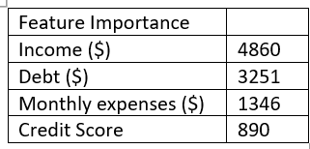
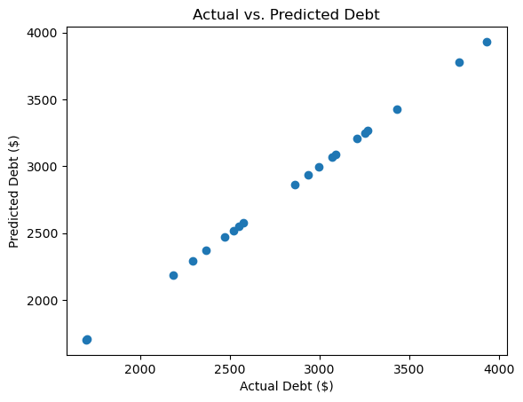
METHODOLOGY
Debt Assessment :This component creates a linear regression model for predicting debt amount based on features like income, existing debt, monthly expenses, and credit score. It then prioritizes debts based on the predicted debt amounts.

Slide 10
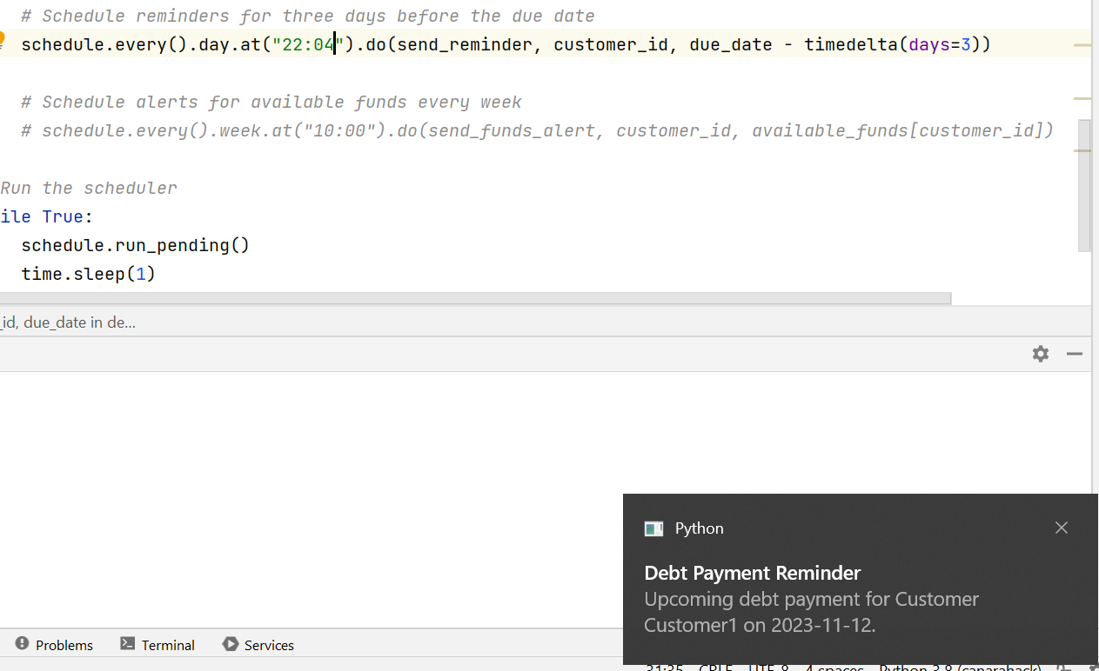
Bill Payment Reminders :This code uses the schedule library to schedule reminders three days before the debt due date and alerts for available funds every week . The plyer library is used to send notifications.

Slide 11
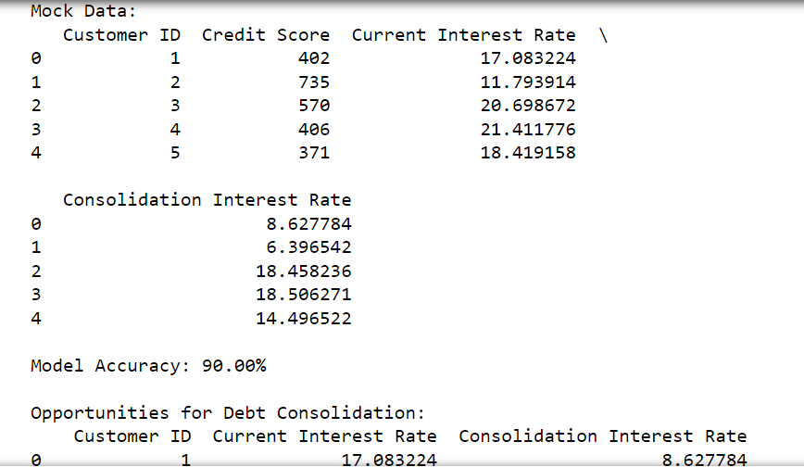
Debt Consolidation Opportunities : The code uses a decision tree classifier to predict whether a customer is likely to benefit from debt consolidation based on features such as current interest rate, consolidation interest rate, and credit score. The model is trained on a subset of the data, and then predictions are made on the entire dataset.

Slide 12
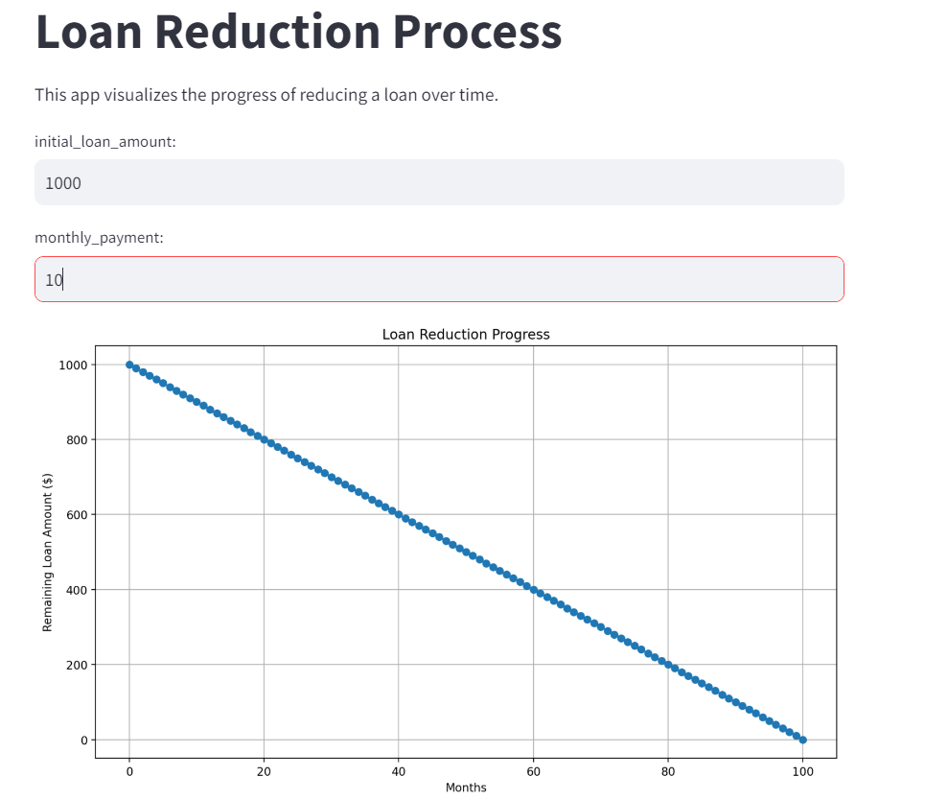
Progress Tracking : Machine learning model to predict debt reduction progress, you'll need historical data on debt amounts, payments made, interest rates, and any other relevant factors.
Emergency Fund Building

Slide 13
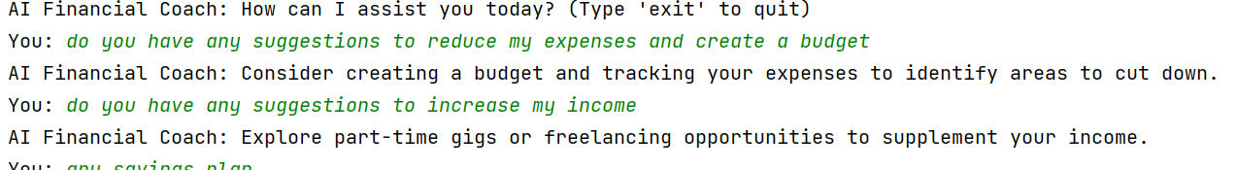
Financial Coaching : One way to create an AI-powered financial coaching system is by implementing a rule-based chatbot . You can use Python along with libraries like NLTK for natural language processing and scikit-learn for text classification.

Slide 14
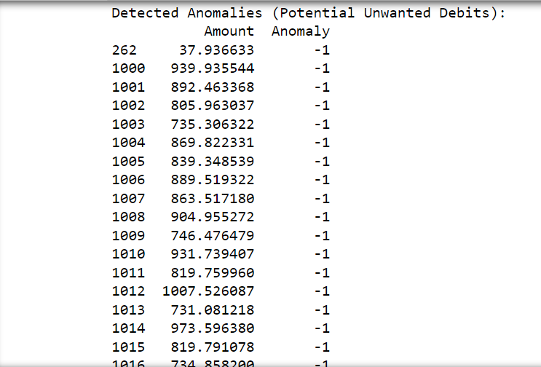
Customized Alerts: Isolation Forest is an anomaly detection algorithm that is particularly useful in identifying outliers or anomalies in datasets.
In this case based on the specifics of the data and the nature of unwanted debits you want to detect.

Slide 15
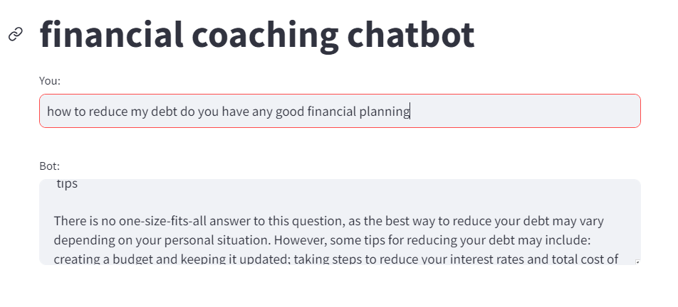
Financial Literacy using LLM: LLM Textdavinci-003 supports financial literacy by explaining terms, guiding through scenarios, answering questions, recommending resources, aiding in budgeting, discussing risks, sharing market insights, and fostering informed decision-making. It simplifies complex concepts, offers practical advice, and encourages wise financial choices through interactive learning and conversation.

Slide 16
Financial Literacy : This script allows a user to input a query related to financial topics . It then scrapes Investopedia's search results for articles related to the query and displays the titles along with their links.

Slide 17
WORKING PROTOTYPE
[ attach Video, link for demo ]

Slide 18
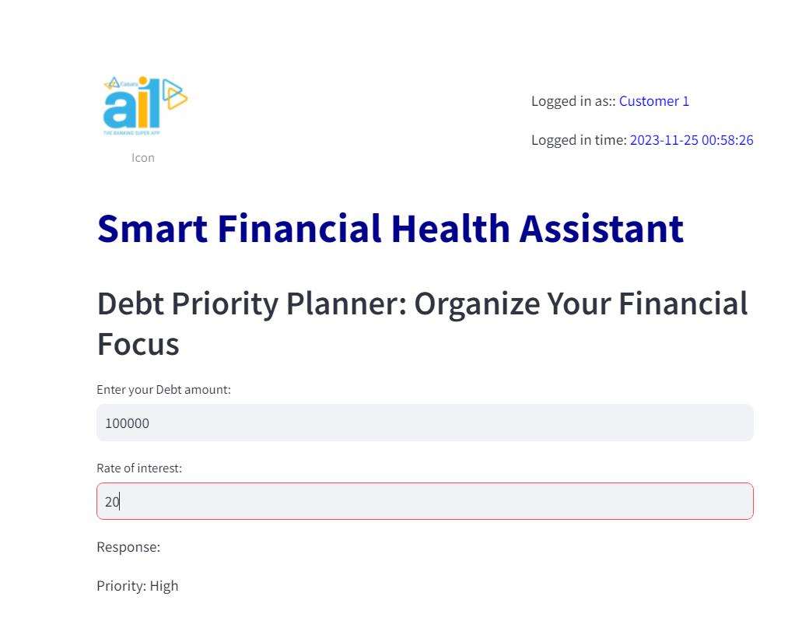
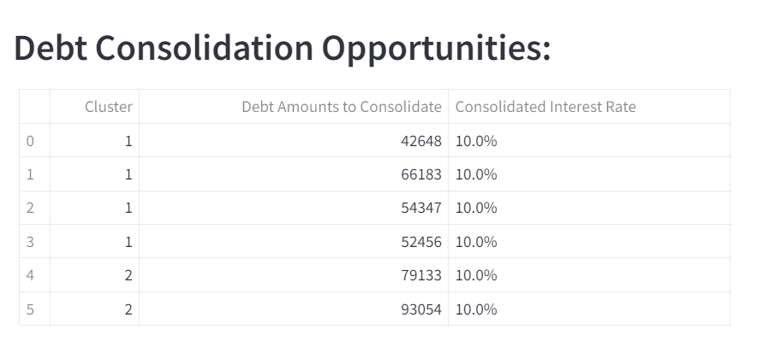
Attachments

Slide 19
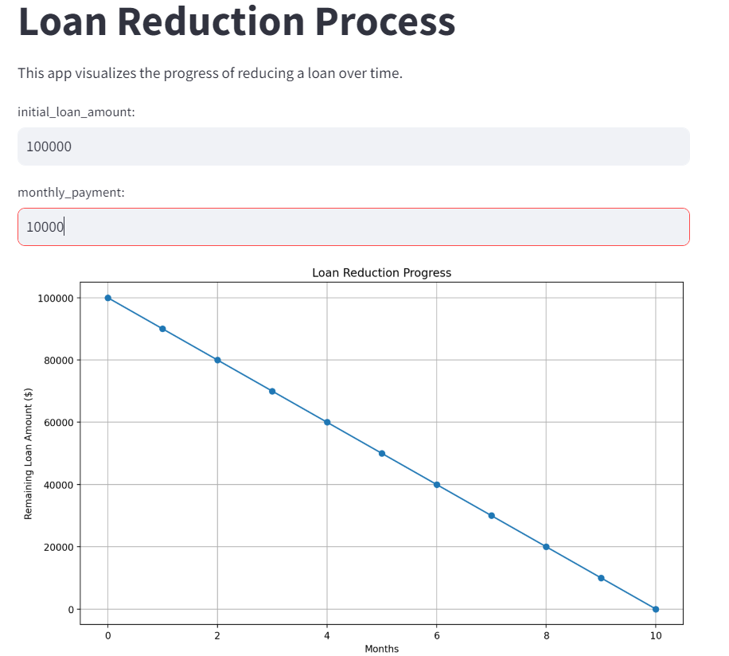
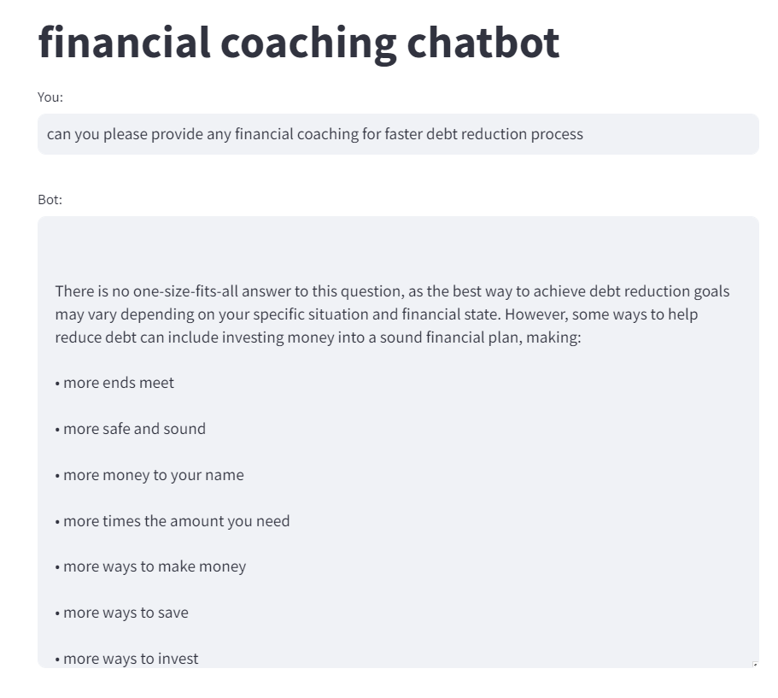
Attachments

